Slide 1
3DTV-CON 2017 is organized by the Architecture, Design & Media Technology Department of Aalborg University Copenhagen and is technically co-sponsored by IEEE Danish section, IEEE Greek CAS/SSC Joint Chapter and IEEE Finnish SP/CAS Joint Chapter

Slide 2
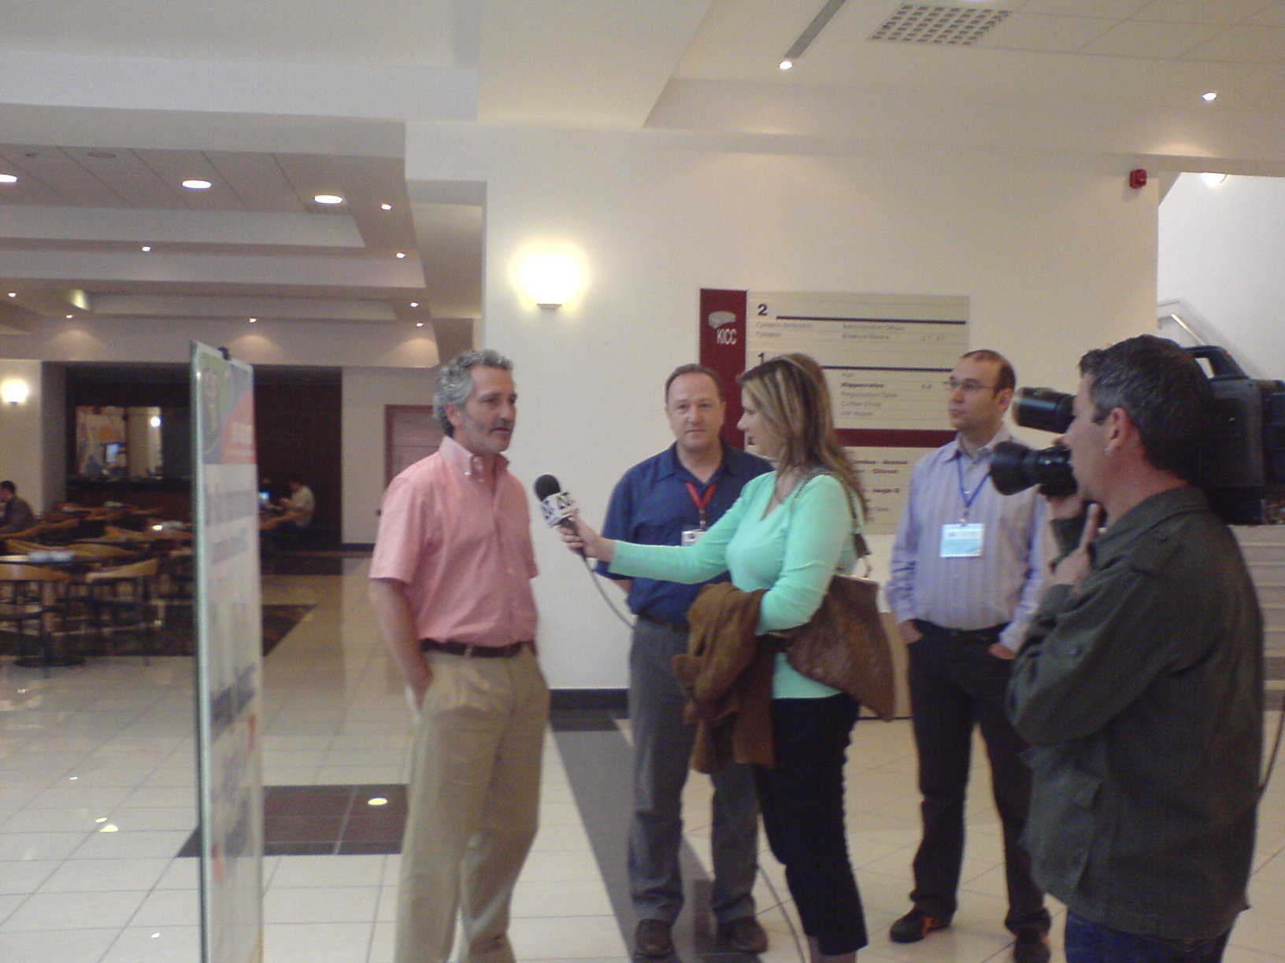
10 years and 1 month before
Notes:
Levent is much more fit and looks young – I have lost my few hair that I had 10 years ago

Slide 3
3DTV-CON 2017: the 11th in the series
2007 Kos Island, Greece,
2008 Istanbul, Turkey;
2009 Potsdam, Germany;
2010 Tampere, Finland;
2011 Antalya, Turkey;
2012 Zurich, Switzerland;
2013 Aberdeen, UK,
2014 Budapest, Hungary,
2015 Lisbon, Portugal
2016 Hamburg, Germany

Slide 4
Practical Information: Session chairs
Session 1: Acquisition systems and coding
Time: Wednesday, 07/Jun/2017: 10:30am - 12:30pm
Location: seminar room 1.001 (Gæstekantinen)
Session Chairs: Gerasimos Arvanitis, Hu Tian
Session 2: 3D displays and visualization
Time: Wednesday, 07/Jun/2017: 1:30pm - 3:30pm
Location: seminar room 1.001 (Gæstekantinen)
Session Chairs: Itaru Kitahara, Georgios Triantafyllidis
Session 3: Evaluation of 3D media
Time: Wednesday, 07/Jun/2017: 3:45pm - 5:45pm
Location: seminar room 1.001 (Gæstekantinen)
Session Chairs: Ismo Rakkolainen, Matthias Ziegler
Session 4: 3D Applications and services
Time: Thursday, 08/Jun/2017: 10:30am - 12:30pm
Location: seminar room 1.001 (Gæstekantinen)
Session Chairs: Dimitrios Tzovaras, Damien Clergeaud
Session 5: 3D in VR
Time: Thursday, 08/Jun/2017: 1:30pm - 3:30pm
Location: seminar room 1.001 (Gæstekantinen)
Session Chairs: Somar Boubou, Alexandros Iosifidis
Session 6: 3D sensors and depth cameras
Time: Friday, 09/Jun/2017: 10:30am - 1:15pm
Location: seminar room 1.001 (Gæstekantinen)
Session Chairs: Federica Battisti, Eleftherios Anastasovitis

Slide 5
Practical Information: Venue
Doors are closing at 17:00
Ex-Nokia Building
Area: Sydhavnen (means south harbour)

Slide 6
Practical Information: Wi-fi
Wi-fi name AAU-CONF-2
Password j58STcz1

Slide 7
Practical Information: Copenhagen

Slide 8
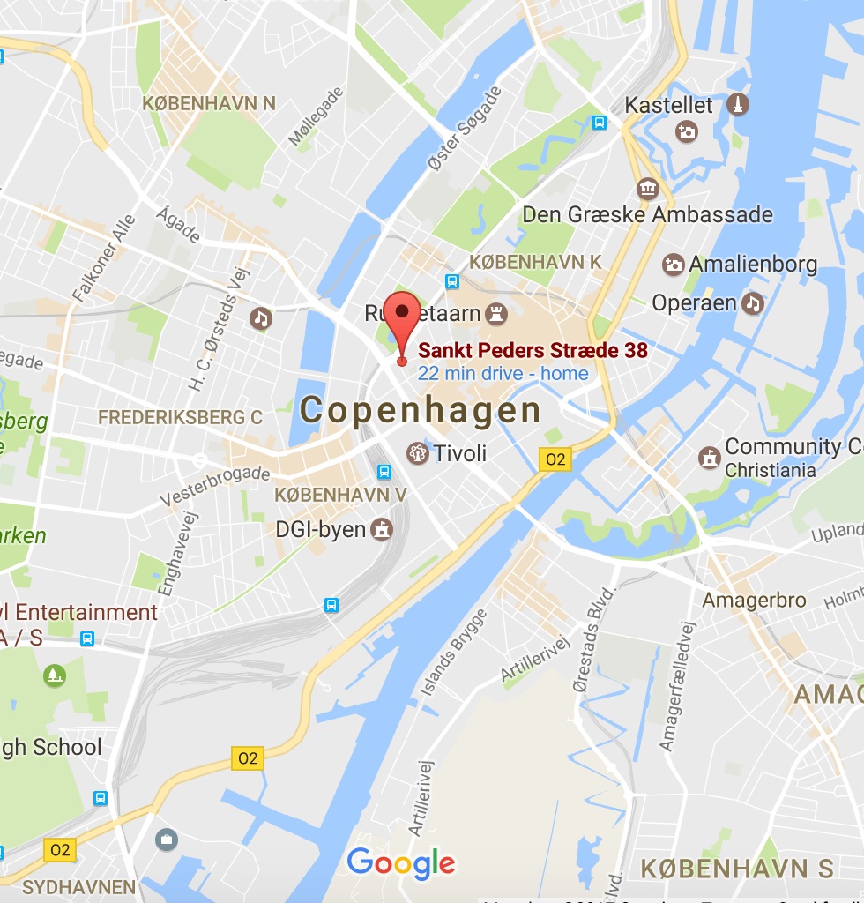
Practical Information: Conf dinner
Cock’s & Cows SP34
Don’t forget the green ticket
(found in you badge holder)

Slide 9
Practical Information: Welcome reception
AAU Copenhagen campus - Today at 18:00 (after the last session)

Slide 10
Practical Information: Lunch coupons
Lunch coupons for AAU canteen
You can get the lunch coupons from the registration desk after the first session is completed (1st coffee break of the day)

Slide 11
Practical Information: weather
Notes:
Let’s now move to the topic that everyone in DK loves to discuss

Slide 12
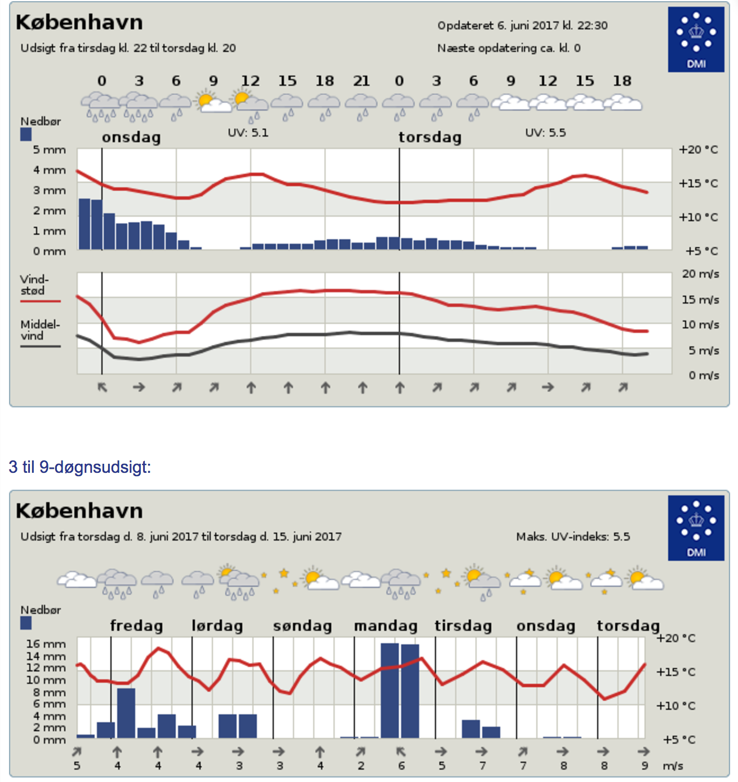
Practical Information: weather
Notes:
specially designed weather

Slide 13
Notes:
specially designed weather

